Slide 1



MACRo 2017
6th International Conference on Recent Achievements in Mechatronics, Automation, Computer Sciences and Robotics
October 27-28 Targu-Mures
Romania
Cyber-Medical Systems: the Digitalized Healthcare Approach and Its Trends
Prof. Dr. habil. Levente Kovács
Óbuda University
Research and Innovation Center of Óbuda University
Physiological Controls Research Center

Slide 2
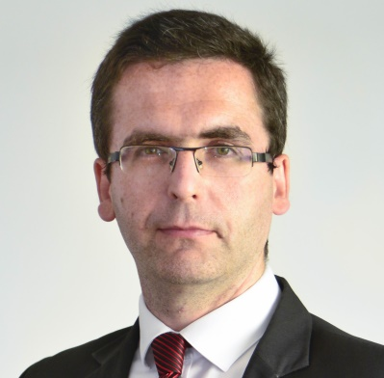

Self-presentation
Dr. habil. Kovács Levente
professor
Scientific publications 2016 publications
  326 • 35
Cumulative IF H-index Independent citations
  34,41 • 13 • 484
Track
  electrical engineer, UPT, 2000
  biomedical engineer, BME, 2010
  PhD, BME, 2008
  habilitation, OE, 2013
  ERC StG grantee, EU, 2015
  professor, OE, 2016
2/78

Slide 3
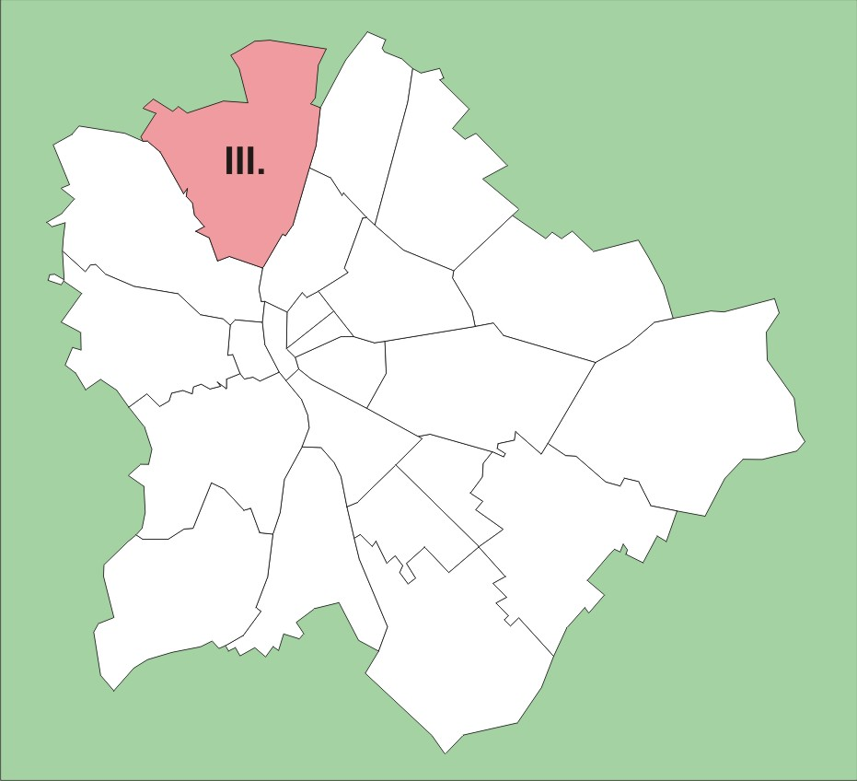
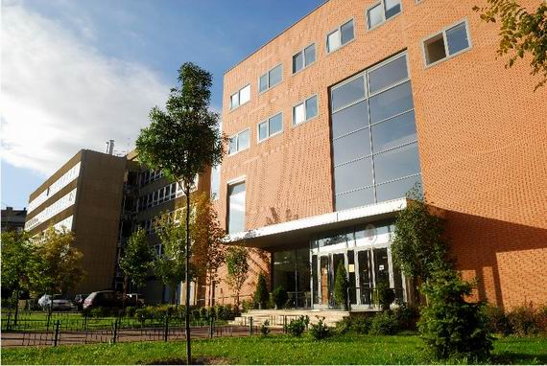
Obuda University today
ca. 13,000 enrolled students
ca. 900 employees
ca. 400 academic staff
3/78

Slide 4
BSc degree
MSc degree
PhD
Mechanical Engineering
Military and Safety technology
Mechatronic Engineering
Technical Teacher Training
Electrical Engineering
Management and Business Administration
Computer Engineering
Light Industry Engineering
Environmental Engineering
Industrial Design Engineering
Commerce and Marketing
Technical Management
Land Surveying and Land Management
Public Administration Management
Engineering Teaching
Enterprise Management
Computer Engineering
Light Industry Engineering
Mechatronical Engineering
Security Technology Engineering
Electrical Engineering
Applied Mathematics
Land Management
Doctoral School of Applied Informatics and Applied Mathematics
Doctoral School of Safety and Security Sciences
Doctoral School of
Material Sciences and Technologies

Slide 5
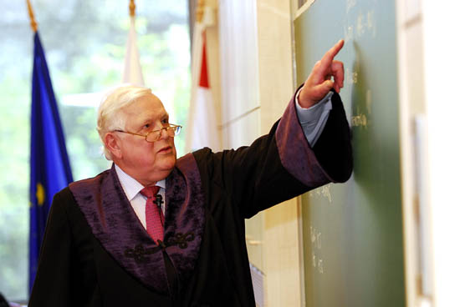
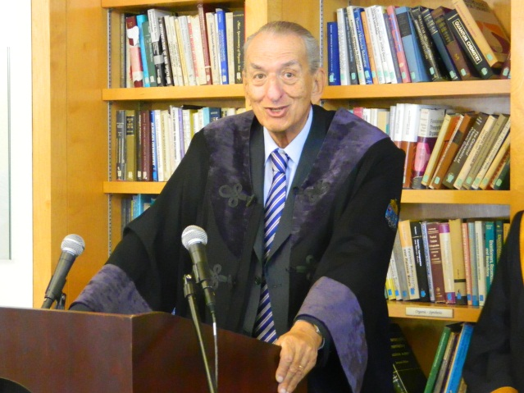
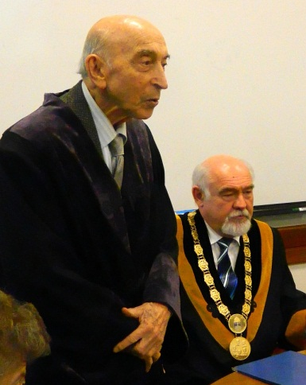
Honorary Doctors of ÓU
Dr. Rudolf KALMAN,
electrical engineer at
ETH Zürich and University of Florida.
Dr. George A. OLAH,
Nobel-laureate chemist at the University of Southern California.
Dr. Lotfi A. ZADEH,
mathematician-engineer at UC Berkeley.

Slide 6
Contents
Industry 4.0 vs Healthcare 4.0 (Cyber-Medical Systems)
Physiological Control: robust control
Physiological Control Research Center (PhysCon)
  Artificial Pancreas project
  Tamed Cancer (ERC StG project)
6/78

Slide 7
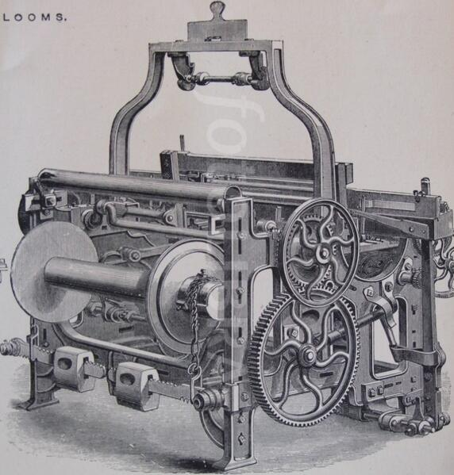
Industry 1.0
Degree of complexity
Mechanical waving loom (1784)
1st industrial
revolution
1st industrial revolution
Through introduction of mechanical production facilities with the help of water and steam power
Mechanical waving loom (1784)
1790s

Slide 8
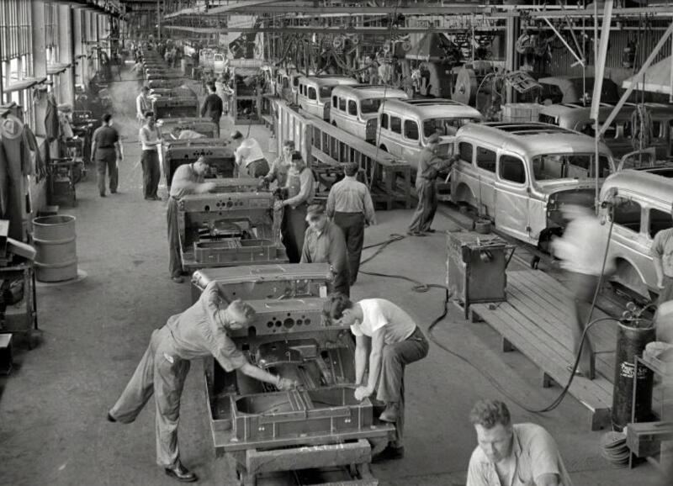
Industry 2.0
Degree of complexity
2nd industrial
revolution
1st industrial
revolution
Assembly line (1870)
2nd industrial revolution
Through introduction of mass production with the help of electrical energy
Mechanical waving loom (1784)
1790s
1870s

Slide 9
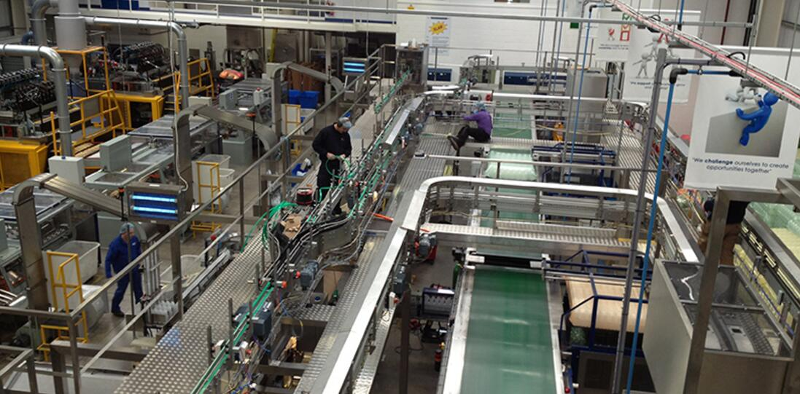
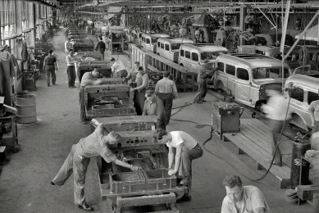
Industry 3.0
3rd industrial
revolution
Degree of complexity
Programmable logic
control system (1969)
2nd industrial
revolution
1st industrial
revolution
Programmable logic control system (1969)
Assembly line (1870)
3rd industrial revolution
Through application of electronics and IT to further automate production
Mechanical waving loom (1784)
1790s
1870s
1970s

Slide 10
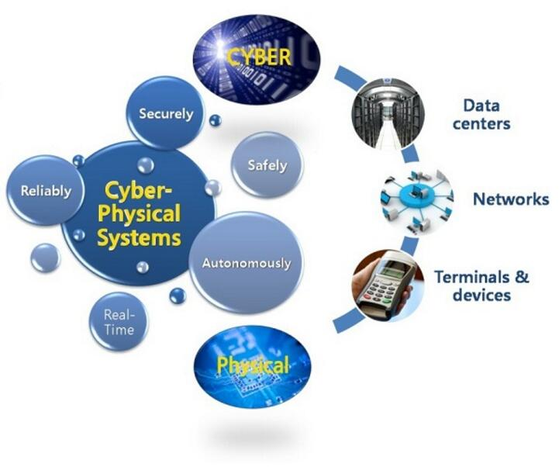
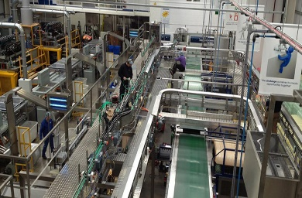
Industry 4.0
4th industrial
revolution
3rd industrial
revolution
Degree of complexity
Cyber-physical
systems
2nd industrial
revolution
Cyber-physical systems (CPS)
1st industrial
revolution
Programmable logic control system (1969)
Industrial 3.0
Assembly line (1870)
Industrial 2.0
4th industrial revolution
On the basis of cyber-physical systems (CPS), merging of real and virtual world
Mechanical waving loom (1784)
Industrial 1.0
Today

Slide 11
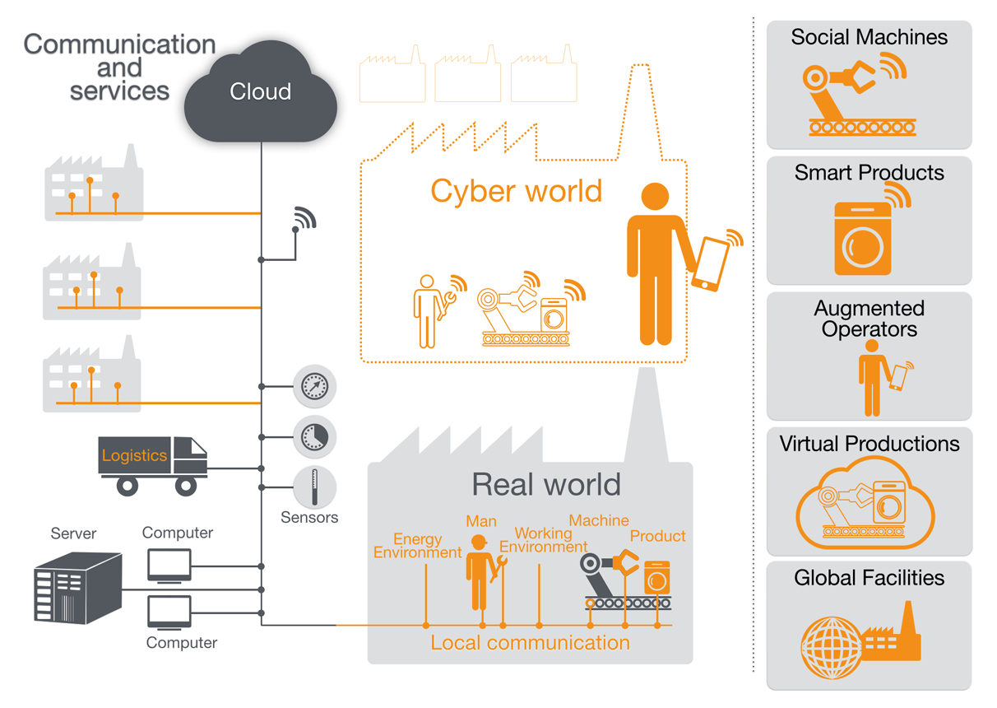
Industry 4.0
11/78

Slide 12
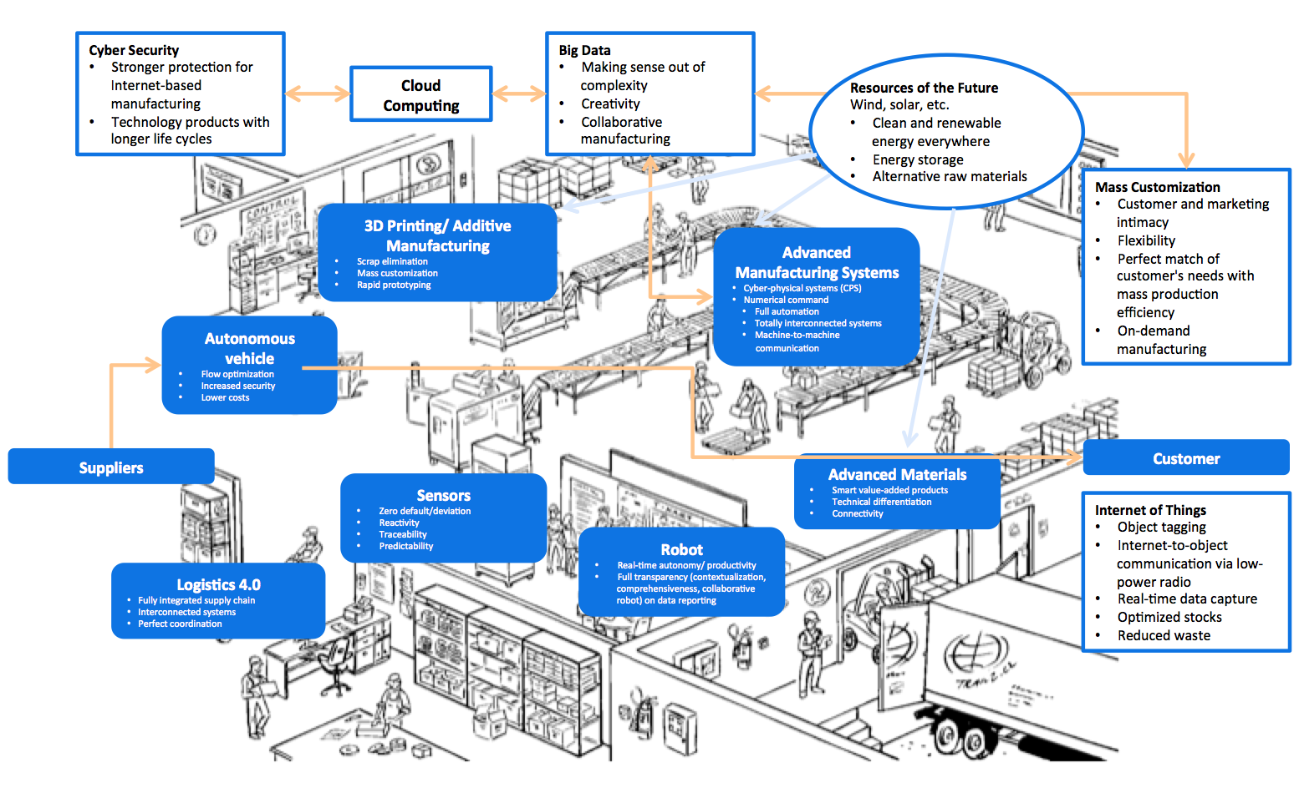
Industry 4.0
12/78

Slide 13
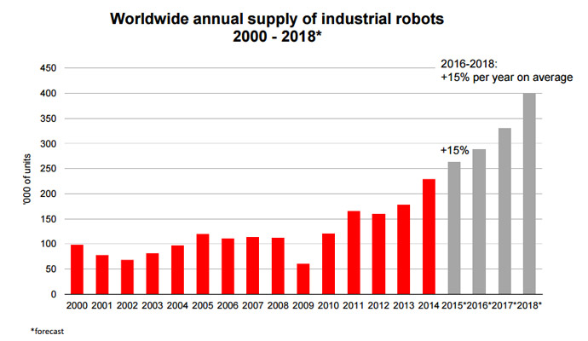
Spread of industrial robots in the world
13/78

Slide 14
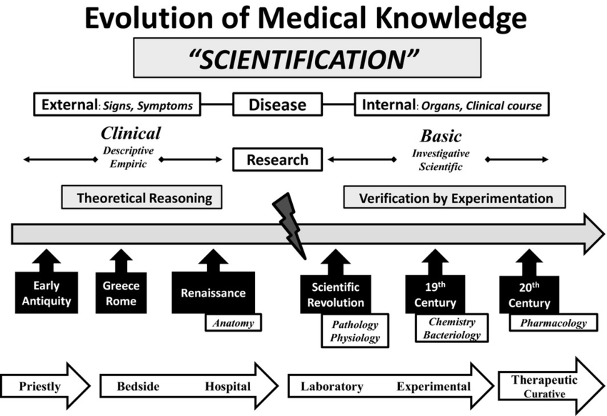
Evolution of Medical Knowledge
1.0
2.0
3.0
4.0
14/78

Slide 15
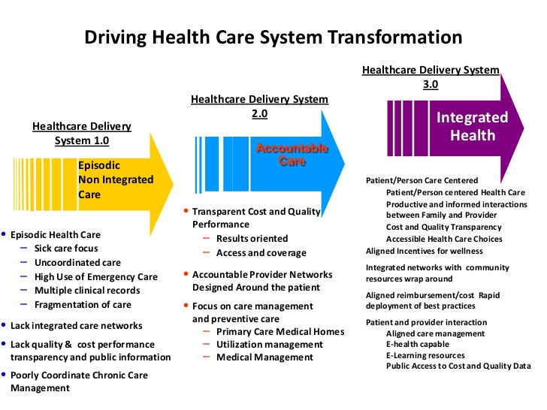
Digitalization of healthcare
15/78

Slide 16
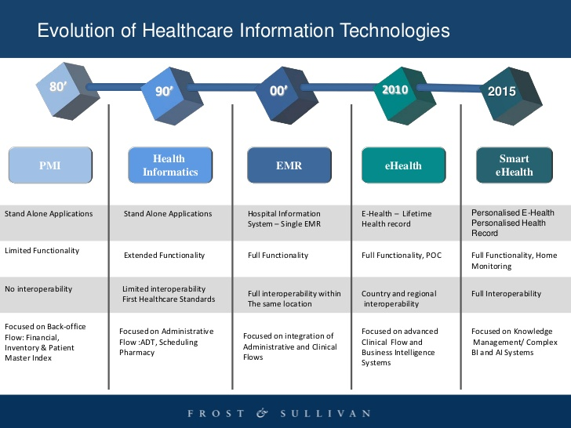
Healthcare digitalization in terms of years

Slide 17

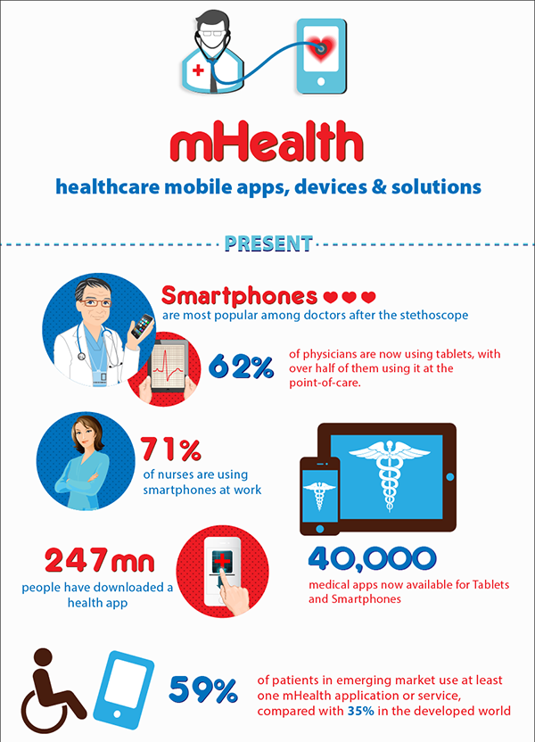
Intentional healthcare behavioral
Higher drug prices
Increase of smartphone nr.
Behavioral healthcare increase
Community-based care
Intentional consumer expenses

Slide 18
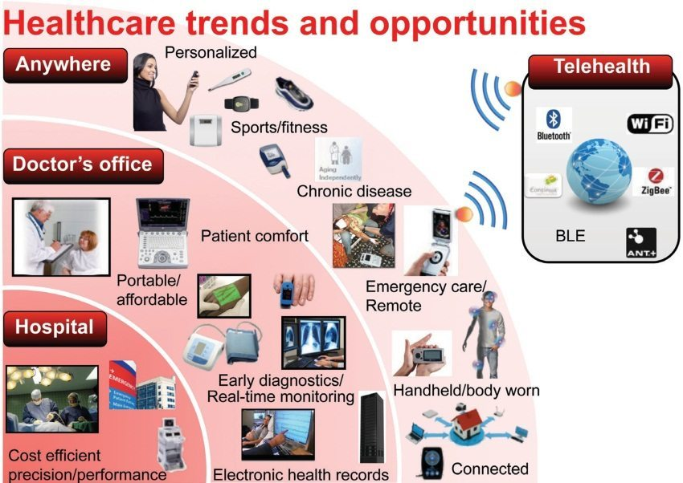

Slide 19
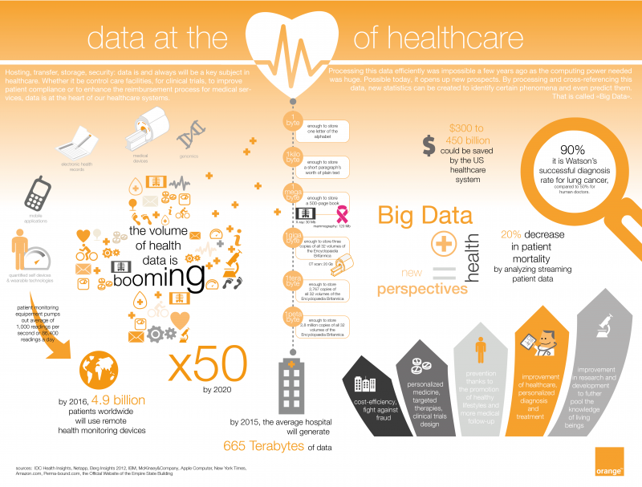
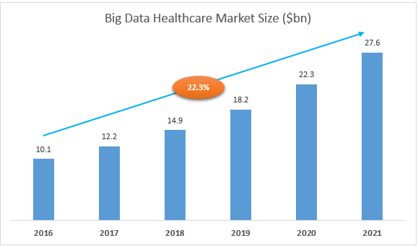

Slide 20


20/78

Slide 21
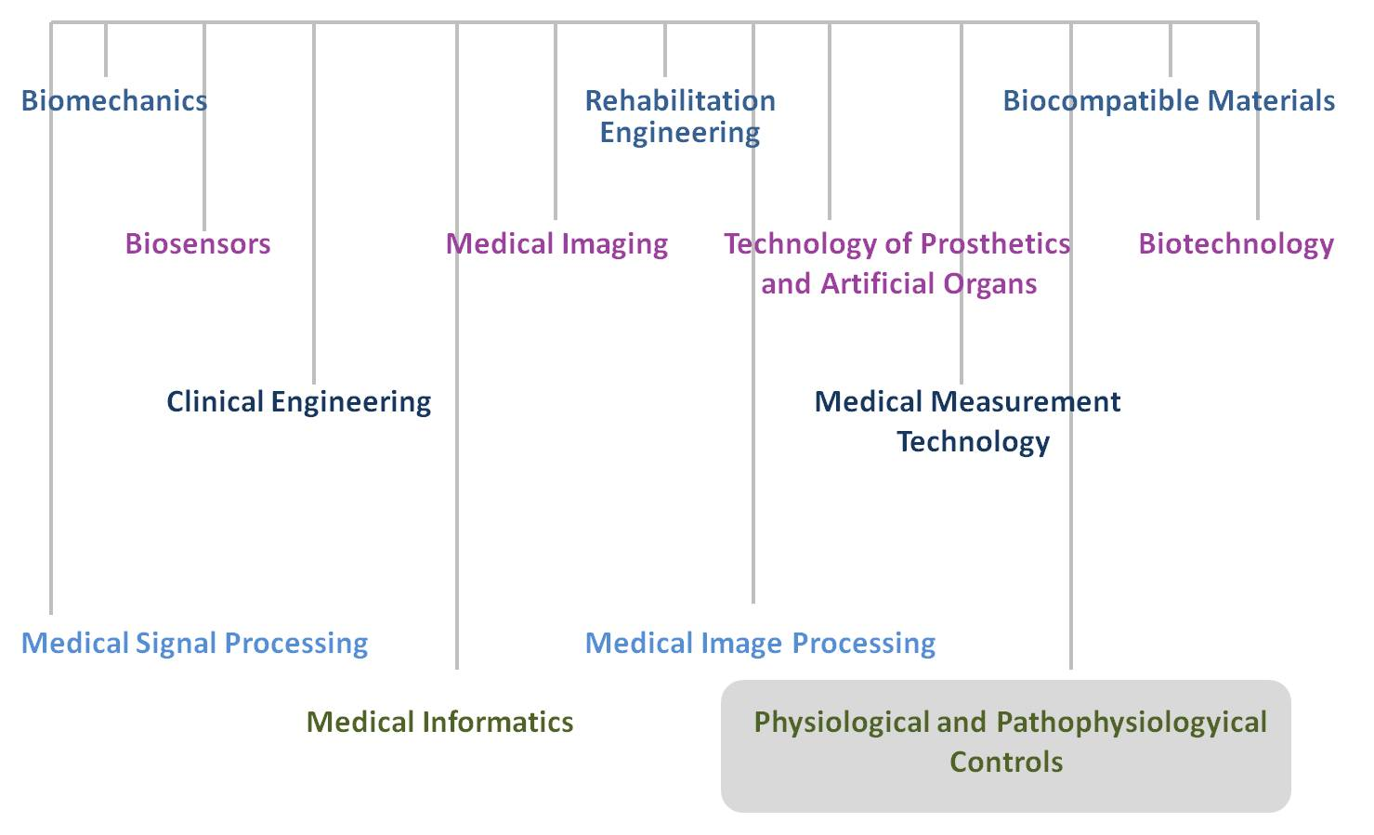
Fields of biomedical engineering
21/78

Slide 22
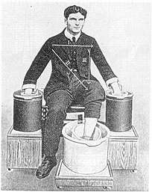
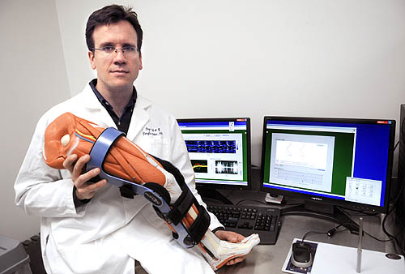
Biomedical engineering
Appeared in the 20th century
Highly interdisciplinary topic
22/78

Slide 23
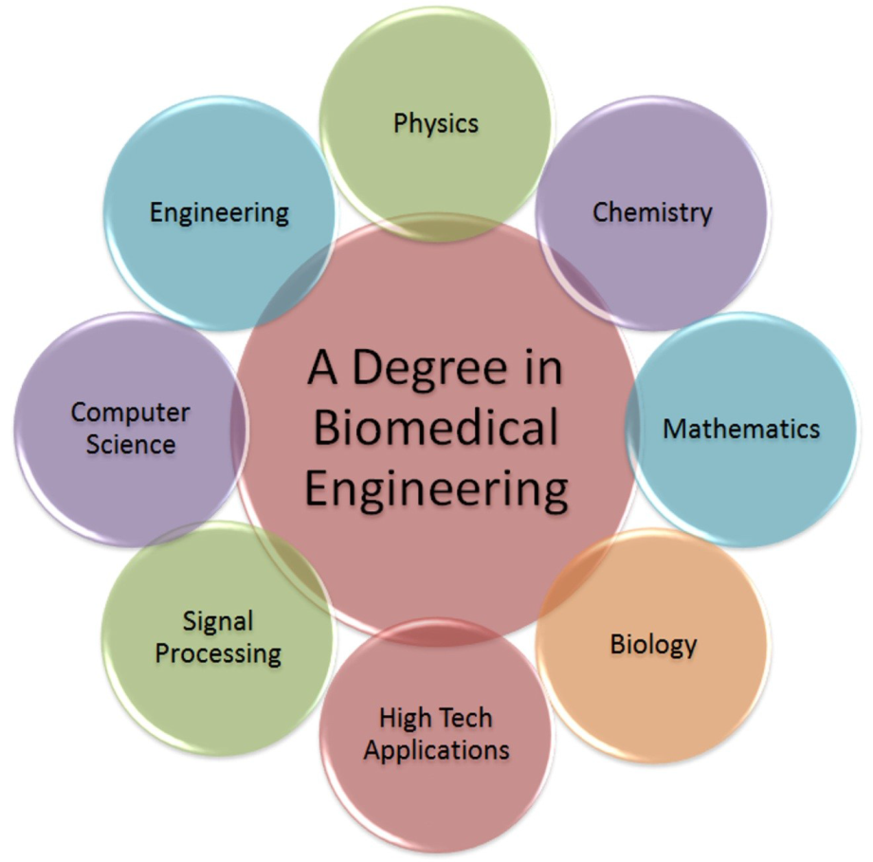
Biomedical Engineering
23/78
http://www.thecb.state.tx.us/index.cfm?objectid=2F5B6F68-F057-67AE-88643B0090CE5CCD

Slide 24
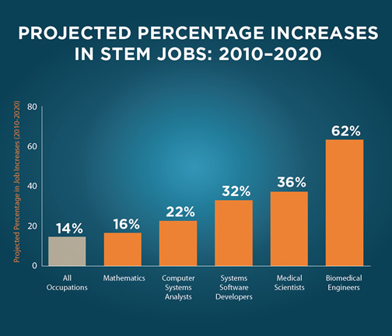
Biomedical Engineering
STEM = academic disciplines in
Science, Technology, Engineering, and Mathematics
24/78

Slide 25
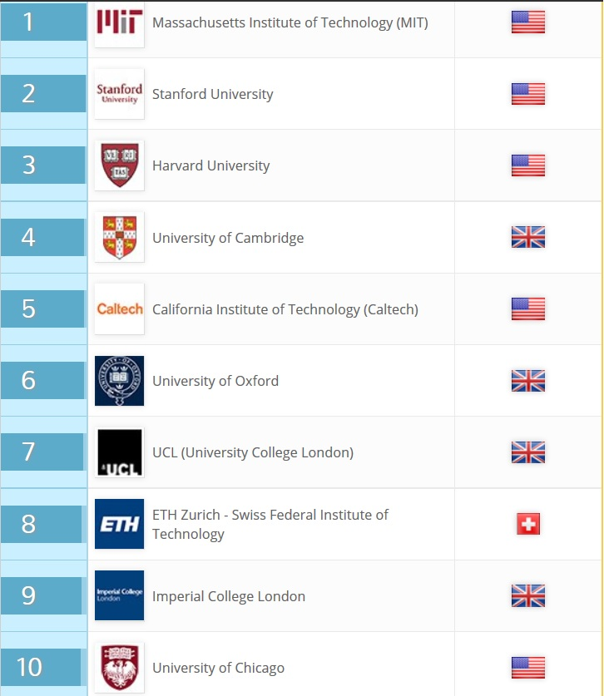
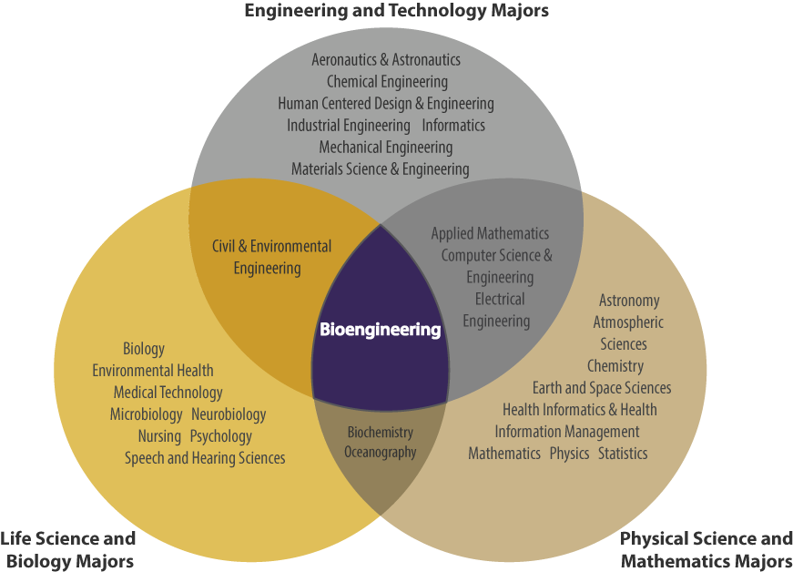
International trends of biomedical engineering education

Slide 26



Research trends - Cyber-Medical Systems (2018-2020)
Personalized healthcare
Big-data
Cloud computations
Digital healthcare
e-Health
Smart & healthy living
Cybersecurity in health
Evidence-based medicine
Physiological modeling and control
Automatic drug-delivery
Personalized Medicine
Smart Cyber-Medical Systems
26/78

Slide 27
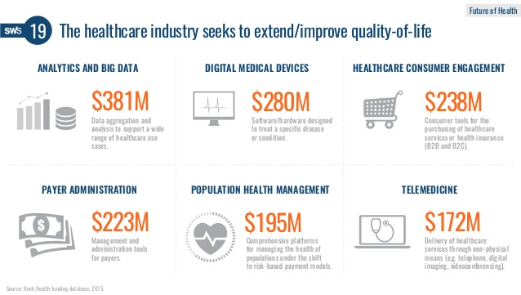
Costs
27/78

Slide 28
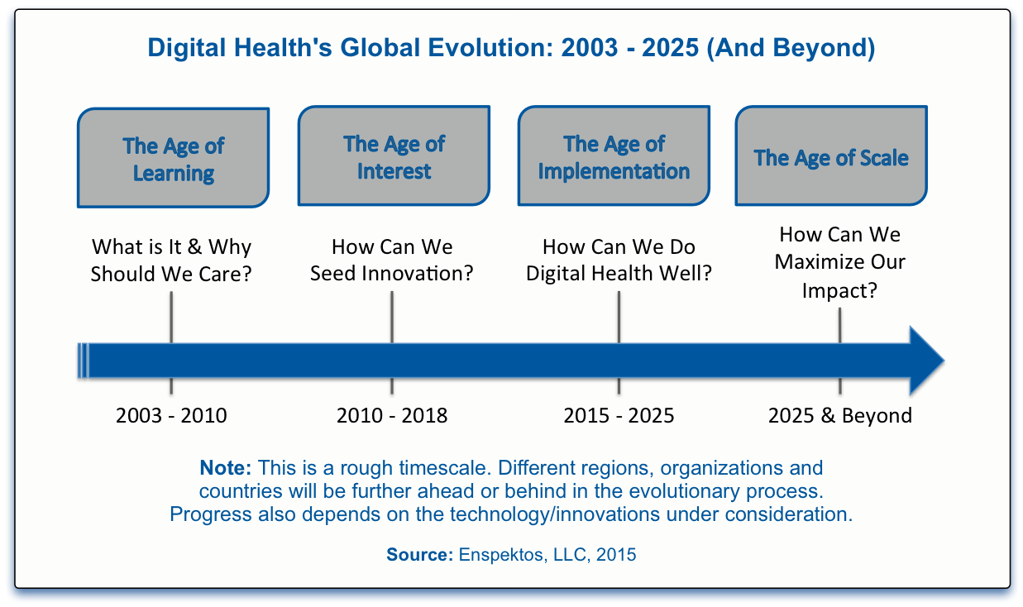
Evolution estimation
28/78

Slide 29


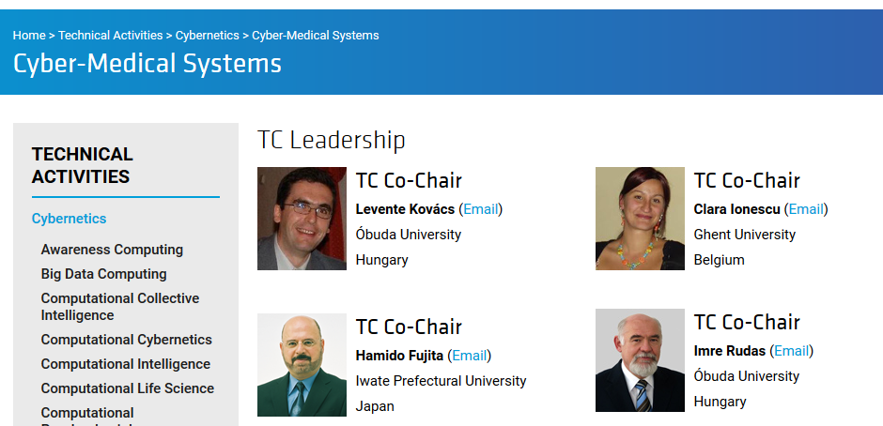
46 international researchers (HU, RO, SVK, BE, P, SG, J, UK, IT, USA)
Aim: promoting theory & practice of personalized healthcare with intelligent healthcare applications & methods

Slide 30



Biomedical Engineering at Obuda University
2012. 11. 20: Biotech Research Center (BioTech)
2013. 11. 20: Antal Bejczy Center for Intelligent Robotics (ABC-iRoB)
2013. 11. 20: Physiological Controls Research Center (PhysCon)
2013. 11. 20: University Research and Innovation Center (EKIK)
30/78

Slide 31
Biomedical Engineering at Obuda University
2014. 09. 01: MSc in Computer Engineering with Medical
Informatics specialization
2015. 11. 12: Biomatics Institute, John von Neumann Faculty of
Informatics (NIK)
NIK
Applied
Informatics
Applied Mathematics
Biomatics
31/78

Slide 32

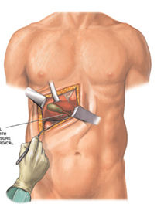
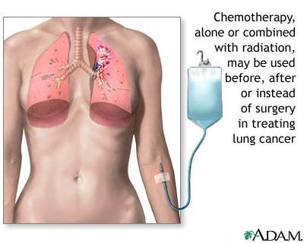
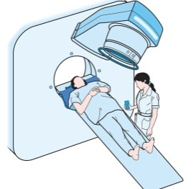
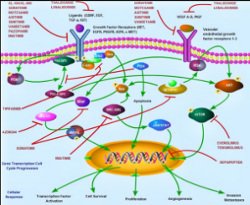





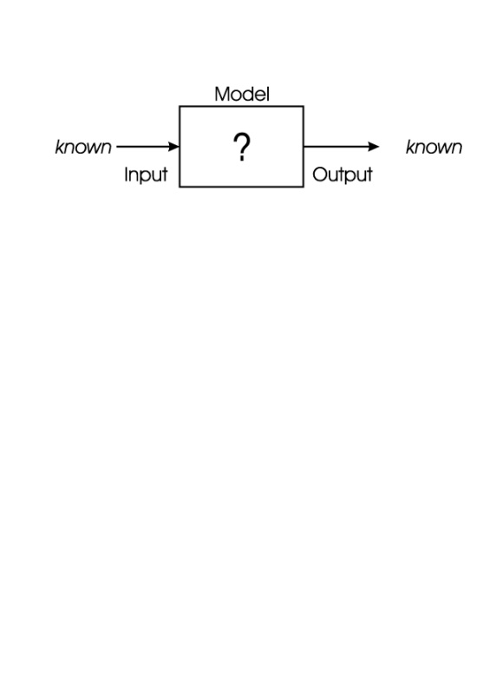
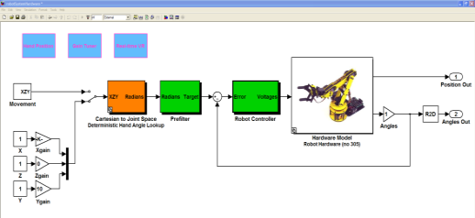
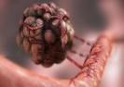
Aim of physiological control
Medical knowledge
General therapies
Patient healing
Efficient / cost effective solutions in healthcare
Personalized healthcare
Model identification
Model-based protocols
Engineering knowledge
32/78

Slide 33
Evolution of control engineering theory
1940s: Empirical control methods (Ziegler-Nichols, Kessler, etc.)
1960s: Classical control methods (PID)
1980s: Modern control methods:
- soft computing (fuzzy, neural systems, genetic algorithms)
- adaptive control
- optimal control
- predictive control
- model predictive control
- nonlinear control methods
1990s: Modern robust control
33/78

Slide 34
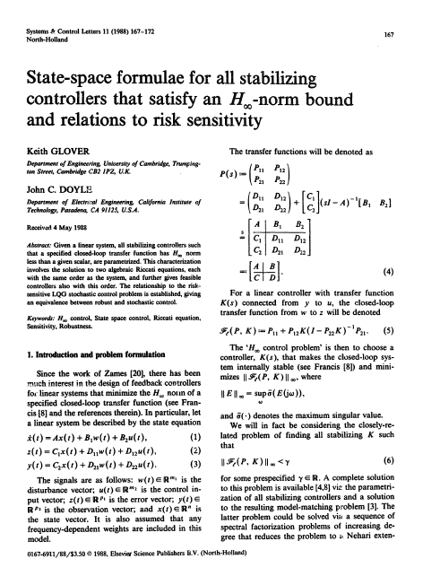

Slide 35
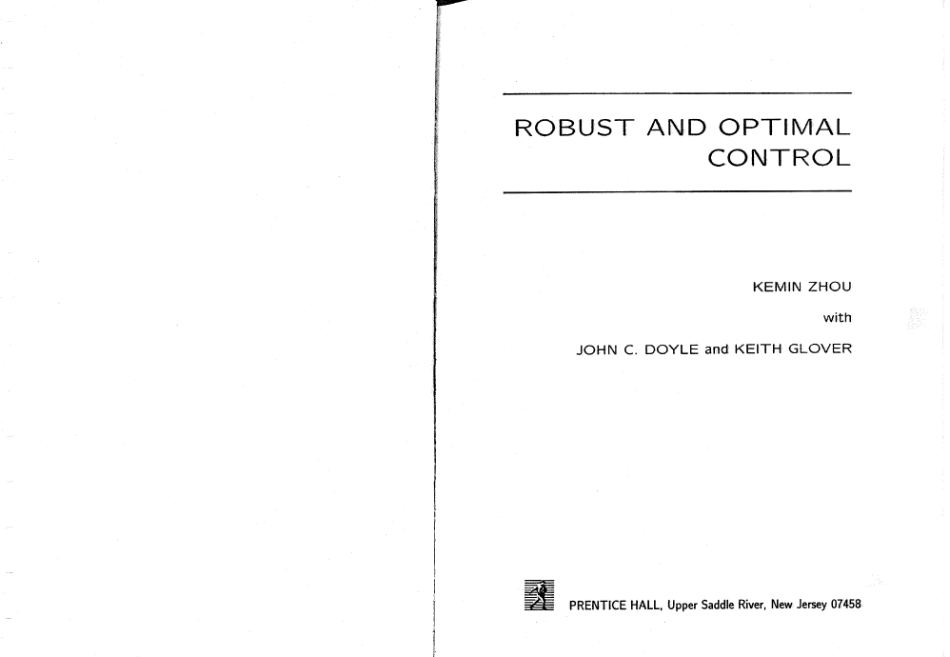
K. Zhou: Robust and Optimal Control, Prentice Hall, New Jersey, 1996.

Slide 36
Aim of modern robust control theory
Basic control requirements:
stability & performance
uncertainty
good path tracking
disturbance rejection
Nominal Performance & Robust Stability
H∞ – minimization in „worst case”
Rationalism (exact formulation)
+ Empiricism (based on expertise)
36/78

Slide 37
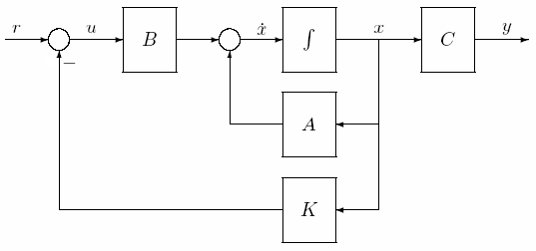
LQ (H₂) control
Disturbance
37/78

Slide 38
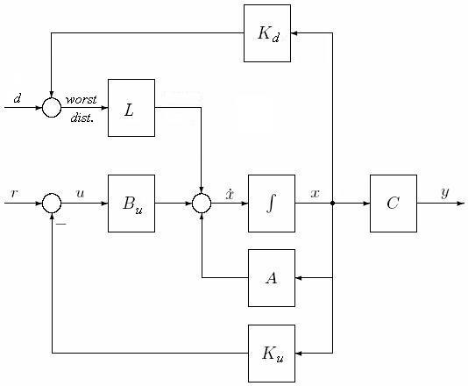
Minimax (H₂/H∞) control
38/78

Slide 39
Solution
Optimal control: Worst case disturbance:
P ≡ solution of MCARE (modified Riccati equation):
Conclusion: for big γ values the minimax problem becomes a classical LQ optimal problem.
39/78

Slide 40
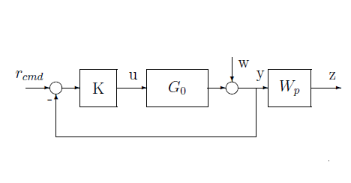

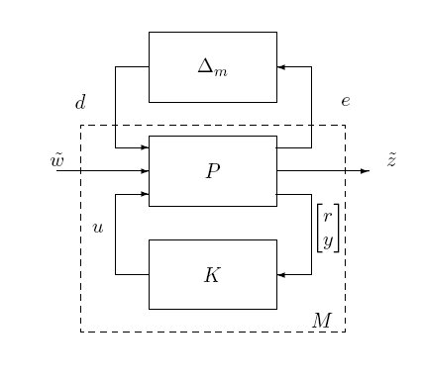
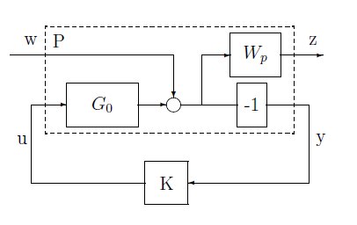

The H∞ control problem
w

Slide 41
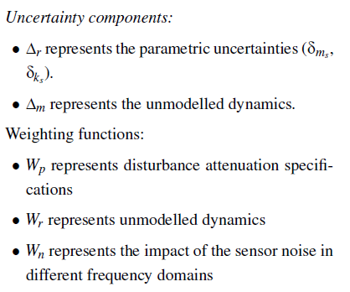
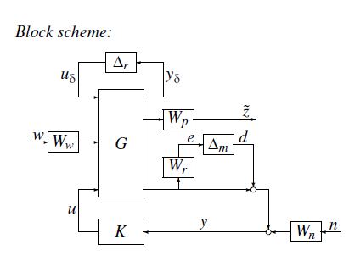
Physiological Controls Group
41/78

Slide 42
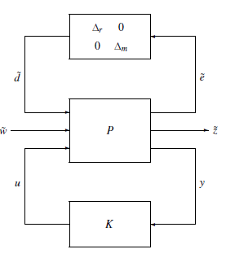
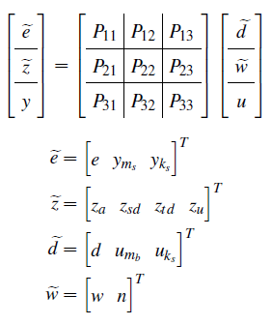

The P-K structure with uncertainty blocks
42/78

Slide 43



The M-D structure
43/78

Slide 44

The optimization criterion of the control design
44/78

Slide 45











Physiological Controls Research Center
Diabetes:
Artificial pancreas
Cancer:
Antiangiogenic TMT
Biostatistics:
Evidence based medicine
Hemodialysis:
Peristaltic pump control
45/78

Slide 46

Artificial Pancreas
46/78

Slide 47



Diabetes – Increasing problem
Not insulin
production
Not enough insulin production
47/78

Slide 48

Blood glucose control
Tight Glycemic Control (TGC):
  already applied in Intensive Care Unit (ICU);
  uses tools and devices already present;
  can reduce morbidity & mortality^{1,2} (and costs³);
Artificial Pancreas (AP):
        glucose control
        needs special hardware - CGMS and insulin pump⁴;
        still at clinical trial phase^{5,6};
1 – SE Capes et al. (2000). Lancet, 355(9206): 773-778.
2 – J Chase et al. (2008). CritiCare, 12:R49.
3 – G Van den Berghe et al. (2006). Crit Care Med, 34(3):612-616.
4 – B.W. Bequette (2005) Diab. Tech and Therap., 28-47.
5 – R. Hovorka (2010) Lancet, 375 (9716): 743-751.
6 – B. Kovatchev (2010) J.Diab Sci Techn, 4: 1374-1381.
48/78

Slide 49


Evolution of AP problem
C Cobelli et al. Diabetes, 60:2672-2682, 2011

Slide 50
Timeline of PhysCon AP research
Developing adequate algorithms 2008
Simulation on clinically recorded data 2010
In-silico validation 2012
Clinical experiments
LPV-based robust (H_{inf}) controller
Literature metrics fitting
50/78

Slide 51
Aim of LPV systems
Nonlinear model based design technique [Tan 1997], [Wu et al. 2000]
2 well-known techniques:
  affine type: a part of the p(t) are equal with the x(t) states
  polytope type: the validity of the model is caught inside a polytope region linear combination of linear models
51/78

Slide 52
LPV control scheme
where
X=X^{T} > 0
γ < 0
L Kovacs et al. Comp Meth Prog Biomed, 102(2):105-118, 2011
52/78

Slide 53

Artificial Pancreas Working Group
10 insulin pump centers (5 in Budapest, 5 countryside)
Created in 2010
(co-leading it with the president of Hungarian Diabetes Association)
53/78

Slide 54

Results
7 years old boy (2 year diabetes, Veszprém’s Hospital)
L Kovacs et al. JDST, 7(3):708-716, 2013
54/78

Slide 55
In silico validations
2011: 20 children, 4 men, 6 women (30 datasets – 1 week)
2012: 43 children, 16 men, 24 women (183 datasets – 1 or 3 w.)
2013: 47 children, 17 men, 24 women (203 datasets – 1 or 3 w.)
 |  | Avg. | Variance | Hypo [%] | Hyper [%] | Normal [%]
In silico | Adult | 5,98 | 1,38 | 0 | 11,93 | 88,07
 | Children | 5,67 | 1,2 | 0 | 5,94 | 91,37
 | SUM | 5,83 | 1,29 | 0 | 8,94 | 89,72
Real data | Adult | 7,91 | 2,77 | 3,84 | 50,85 | 45,3
 | Children | 8,72 | 2,52 | 2,28 | 58,77 | 38,95
 | SUM. | 8,32 | 2,65 | 3,06 | 54,81 | 42,13
L Kovacs. Knowl-Based Syst, 122:199-213, 2017
55/78

Slide 56
Literature-based metrics (CVG)
Three protocols: 150g CHO;
215g CHO;
irregular and inexactly determined (±20 g CHO) meal
P Szalay, L Kovacs. IFAC WC 2014, pp. 9247-9252, August 2014
56/78

Slide 57

Personalized Cancer Therapy by Model-based Optimal
Robust Control Algorithm
http://physcon.uni-obuda.hu/?q=hu/node/47

Slide 58
Cancer statistics
EU 2016: ≈ 1,3 million tumor-related deaths¹
Hungary^{2,3}:
  Leading in the EU!!
  Listed 3rd in the World:
    Listed 1st among men: 235.5/100000.
1 – M. Malvezzi et al. Ann Oncol, 00: 1-7
2 – http://rex.nci.nih.gov/NCI_Pub_Interface/raterisk/rates38.html
3 – http://chartsbin.com/view/lhq.4
58/78

Slide 59




Antiangiogenic therapy
Classical therapies
Targeted molecular therapies
Antiangiogenic therapy
59/78

Slide 60

Mission
drug-delivery
Optimal
control algorithm
efficiency
Model-based personalized treatment
Less harmful cancer therapy
Increased life expectancy
Tamed cancer
60/78

Slide 61
Concept of the research
Individualization level
Quality of life (QoL)
Controller-based
individualized
treatment
high
virtually no
side effect
infrequent
and limited
side effects
Targeted molecular
therapies (TMTs)
moderately high
frequent
and serious
side effects
Conventional cancer therapies
(chemotherapy, radiotherapy)
poor
low
medium
high
Cost of the
treatment

Slide 62




Tumor volume control – output simulation results
Current (Hungarian)
medical protocol
No treatment
Tumor volume [mm³]
Control approach
Robust control
Nonlinear control (LPV)
Empiricism & Rationalism
Kovács, L. et al. Comp Meth Prog Biomed, 114:98–110., 2013
62/78

Slide 63
State of the art timeline
Harvard (USA)
New Jersey (USA)
Harvard (USA)
&
Obuda (HU)
Obuda (HU)
Model
1999
2004
2007
2010
2011
2013
2014
2015
Casablanca (Morocco)
Obuda (HU)
Rome (IT)
Illinois (USA)
Obuda (HU)
Control
Obuda (HU)
&
Rome (IT)
Illinois (USA)
Sápi, J, Kovács, L et al. Opt Cont Appl Meth, 37(5):848-886, 2016
Sápi, J, Kovács, L et al. PLoS ONE, 10(11):e014219, 2015
63/78

Slide 64
Methodology
Engineering side
Medical side
Animal experiments
(constant quasi-continuous low-dosage)
1st year
LPV-based robust control
(Harvard-model)
Model identification
Determine most effective therapy
O1
Novel tumor growth model
Novel treatment protocol
O2
2nd year
Continuous time controllers
Therapy validation
In silico simulations variable
quasi-continuous low-dosage administration
Model validation
Therapy validation by further animal experiments
3rd–5th year
O3
Evidence-based personalized cancer therapy

Slide 65
1st year summary
Protocol based vs discrete-time controller
based treatments
Optimal discrete time control
Positive nonlinear control
A bicompartmental dynamic tumor growth model
A minimal model of tumor growth
New control strategies for the Hahnfeldt model
New tumor
growth models
65/78

Slide 66


Protocol based vs discrete-time controller based treatments
Protocol based cancer therapies
1. intermittent bolus doses (BD) administration
patient receives drug on given days
therapy has rest periods
types:
  maximum tolerated dose (BD MTD)
    high dose injections with extended rest periods
  bolus dose (BD)
    lower dose injections with shorter rest periods
  low-dose metronomic (LDM) regimen
    low doses over prolonged periods without extended rest periods
time (days)
2. continuous infusion therapy (cont)
time (days)
66/78

Slide 67

Protocol based vs discrete-time controller based treatments
Discrete-time control containing state feedback, setpoint control,
actual state observer and load estimation
J. Sápi, D.A. Drexler, L. Kovács, Acta Poly Hung, 14(1):11-23, 2017
67/78

Slide 68

Protocol based vs discrete-time controller based treatments
BD MTD – maximum tolerated dose
BD – bolus doses
LDM – low-dose regimen
cont – continuous infusion therapy
J. Sápi, D.A. Drexler, L. Kovács, Acta Poly Hung, 14(1):11-23, 2017
68/78

Slide 69

Optimal discrete time control
Tumor volumes and inhibitor levels with optimal drug injections
D.A. Drexler, J. Sápi, L. Kovács, IFAC WC 2017, pp. 14046 - 14051, July 2017
69/78

Slide 70

Positive nonlinear control (path tracking, state estimation)
D.A. Drexler, J. Sápi, L. Kovács, IFAC WC 2017, pp. 15633 - 15638, July 2017
70/78

Slide 71


Positive nonlinear control
Tumor volumes and inhibitor levels during the simulations with different time constants for the reference signal
D.A. Drexler, J. Sápi, L. Kovács, IFAC WC 2017, pp. 15633 - 15638, July 2017
71/78

Slide 72



A bicompartmental dynamic tumor growth model
tumor core and periphery layer
volumes and concentrations
nutrient access
tumor angiogenic factor production
proliferation and necrosis
non-spouting vasculogenesis:
vessel co-option
D. Csercsik, J. Sápi, L. Kovács, IFAC WC 2017, pp. 12727 - 12732, July 2017
72/78

Slide 73
A minimal model of tumor growth
D.A. Drexler, J. Sápi, L. Kovács, Complexity, in press, 2017
73/78

Slide 74
A minimal model of tumor growth
Parametric identification with linear least square estimation
Validation of the results
D.A. Drexler, J. Sápi, L. Kovács, Complexity, in press, 2017
74/78

Slide 75






Dream (within 15 years)
+
-
75/78

Slide 76
Conclusions
Cyber-Medical Systems & Industry 4.0
  Synergies, new challenges & possibilities
  New education fields
New robust control directions:
  modeling: TP, LPV-LMI, fractional-order
  control: distributed (Youla-parametrization), RFPT, hierarchical control (LMI & individualized)
76/78

Slide 77







PyhsCon team members
Dr. Tamás Ferenci
senior lecturer
Σ publications = 140
H-index = 5
2016 publications = 26
Dr. Johanna Sájevicsné Sápi
senior lecturer
Σ publications = 31
H-index = 7
2016 publications = 3
György Eigner
PhD student
Σ publications = 31
H-index = 1
2016 publications = 10
Dr. Dániel András Drexler
senior lecturer
Σ publications = 47
H-index = 6
2016 publications = 5
Dr. Dávid Csercsik (PPKE)
Post-Doc
Σ publications = 44
H-index = 4
2016 publications = 4
Krisztina Geresdi
research assistant
77/78

Slide 78
MACRo 2017
6th International Conference on Recent Achievements in Mechatronics, Automation, Computer Sciences and Robotics
October 27-28 Targu-Mures
Romania
Thank you for your attention!
Contact:
Prof. Dr. Levente Kovács kovacs.levente@nik.uni-obuda.hu
Óbuda University
Research and Innovation Center of Óbuda University
Physiological Controls Research Center

